Slide 1
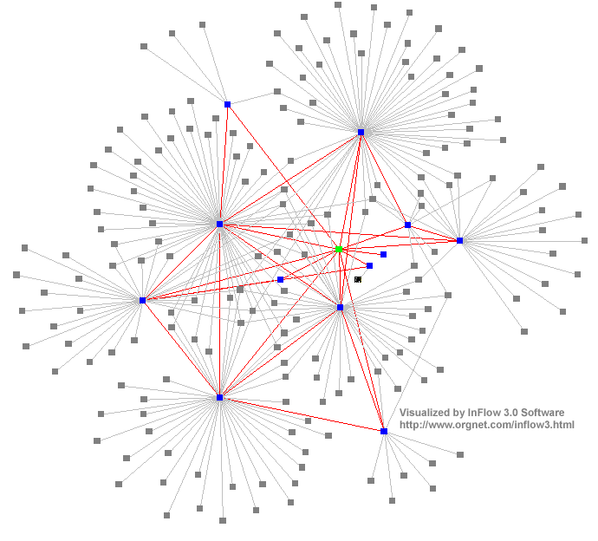
Distributed Systems : System Models
Dr. Sunny Jeong. spjeong@uic.edu.hk
Mr. Bill Junru ZHONG billjrzhong@uic.edu.hk
With Thanks to Prof. G. Coulouris, Prof. A.S. Tanenbaum and
Prof. S.C Joo
Notes:
35

Slide 2
Overview
System architectures
Software layers
Architectural models
  client-server model, peer process model
  mobile code, agents,...
  Modification of Client/server model
    The partition of data or replication at cooperating servers
    The caching of data by proxy server and clients
    The use of mobile code and mobile agents
    The requirement to add and remove devices in a convenient manner
Design requirements
  user expectations of the system

Slide 3
Overview ctd
Fundamental(for common goal) models (for message communication over a computer network)
  Interaction model
    Message delivery
  Failure model
    Reliable communication
    Correct processes
  Security model
    Secure against threats
Summary

Slide 4
Architectural Styles (1)
Important styles of architecture for distributed systems
  Layered architectures
  Object-based architectures
  Data-centered architectures
  Event-based architectures

Slide 5
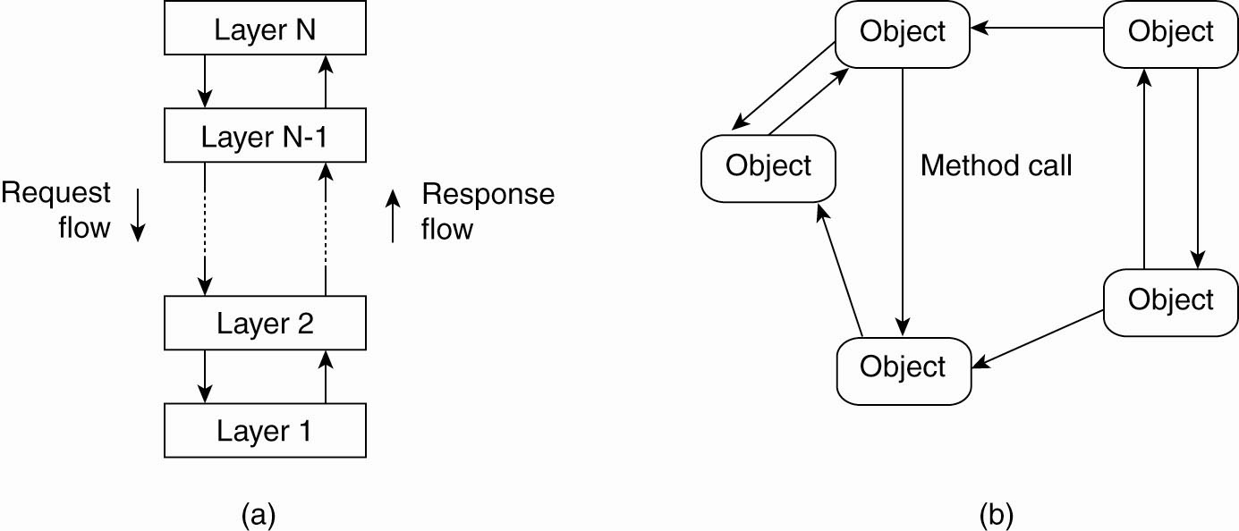
Architectural Styles (2)
layered architectural style and …

Slide 6
Architectural Styles (3)
The object-based architectural style.

Slide 7
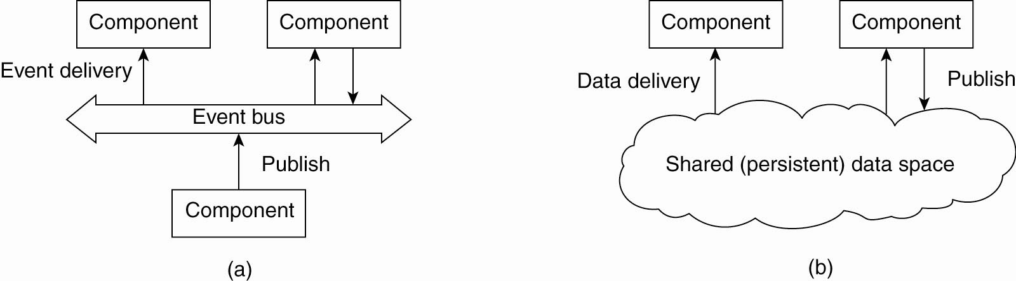
Architectural Styles (4)
The event-based architectural style and …

Slide 8
Architectural Styles (5)
The shared data-space architectural style.

Slide 9
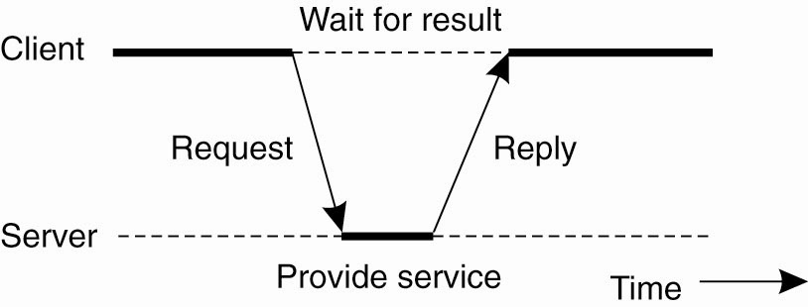
Centralized Architectures
General interaction between a client and a server.

Slide 10
Application Layering (1)
Recall previously mentioned layers of architectural style
  The user-interface level
  The processing level
  The data level

Slide 11
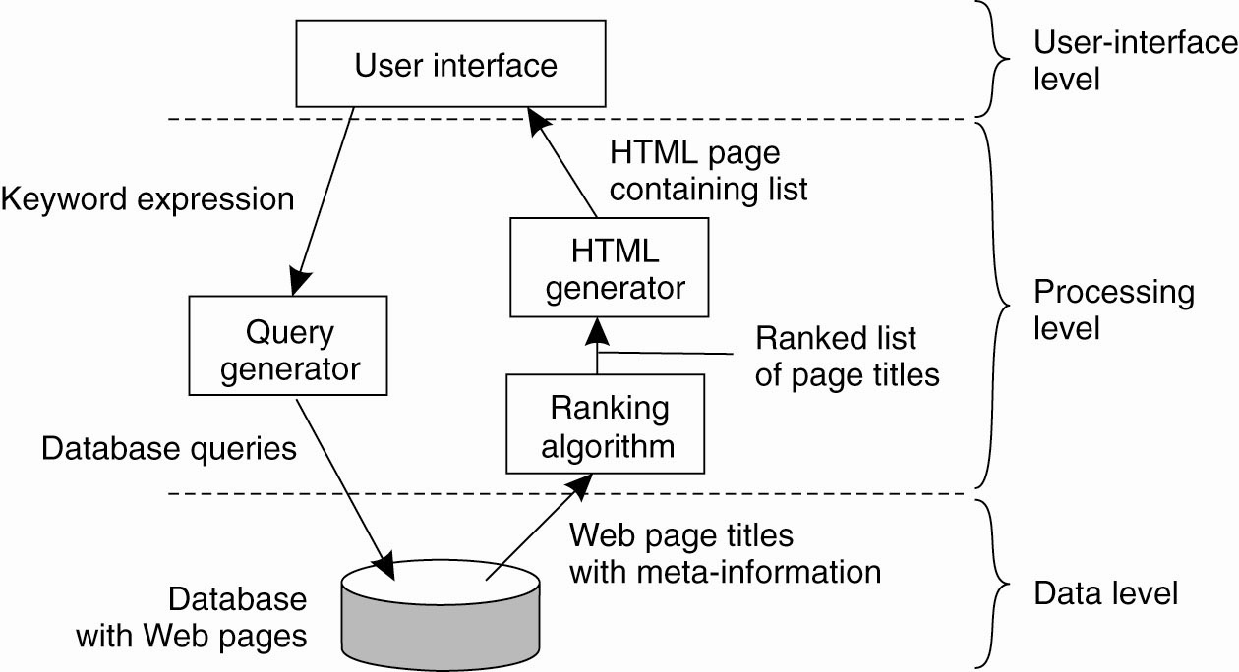
Application Layering (2)
The simplified organization of an Internet search engine into three different layers.

Slide 12
Multitiered Architectures (1)
The simplest organization is to have only two types of machines:
  A client machine containing only the programs implementing (part of) the user-interface level
  A server machine containing the rest,
    the programs implementing the processing and data level

Slide 13
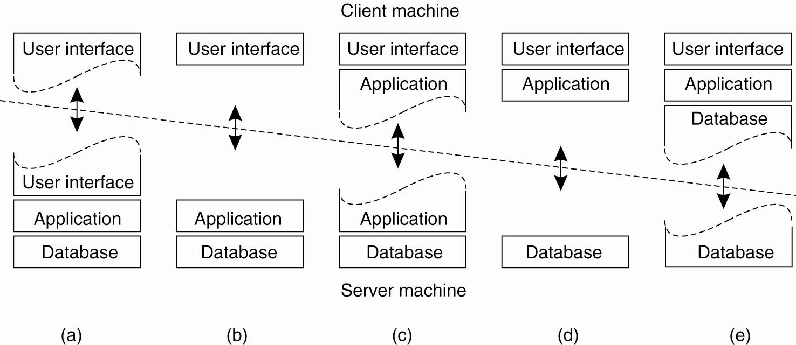
Multitiered Architectures (2)
Alternative client-server organizations (a)–(e).

Slide 14
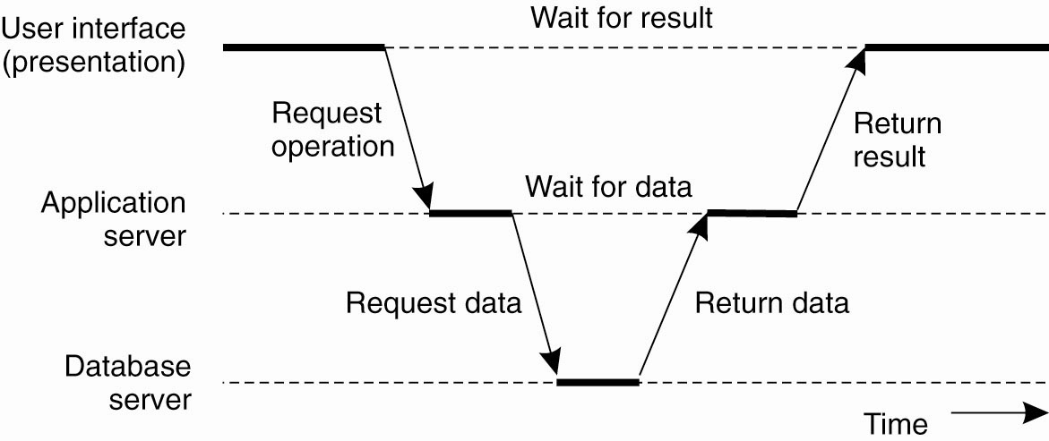
Multitiered Architectures (3)
An example of a server acting as client.

Slide 15
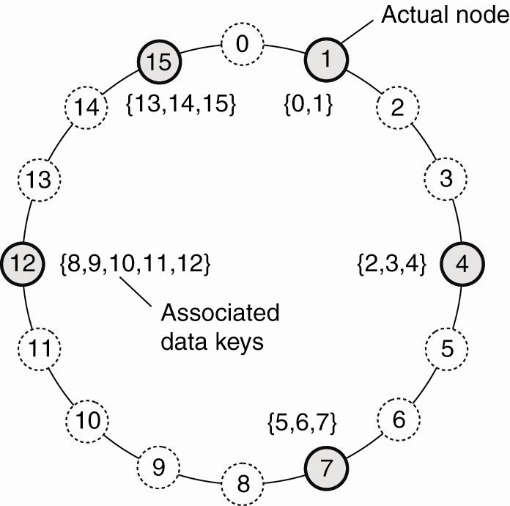
Structured Peer-to-Peer Architectures (1)
The mapping of data items onto nodes in Chord.

Slide 16
Example: Paperless Office
Requirements
  input and storage of scanned documents
  viewing/printing of documents on demand
  networking for resource sharing and communications
  accounting and data analysis
Required properties
  no loss/corruption/unauthorized access of data
  fast response
  should grow as the business expands

Slide 17
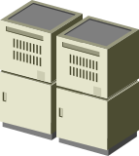

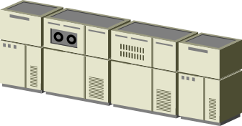


Distributed Design of paperless office ctd
Customer services
Postal service
Scanner
Database
Server
Mainframe
Printer Server

Slide 18

Client-Server Systems
One Tier Architecture
Two Tier Architecture
Network computer, or
PC with terminal
emulation
Presentation (to clients)
+ processing (transactions, applications)
+ data (management & access)
Client-server:
“fat client”
or “fat server”
workstations
1) Presentation + processing
2) presentation
Data (remote data access)
Data processing
(remote procedure call)

Slide 19
Client-Server Systems ctd
Three Tier Architecture
Two tier is satisfactory for simple client-
server applications, but for more
demanding transaction processing
applications”
clients
shared application
services
shared data services
Presentation
processing
data
remote data access,
procedure call
remote data access or
transaction processing

Slide 20
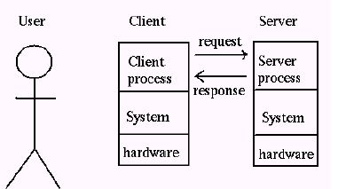
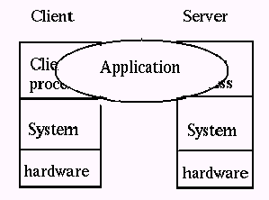
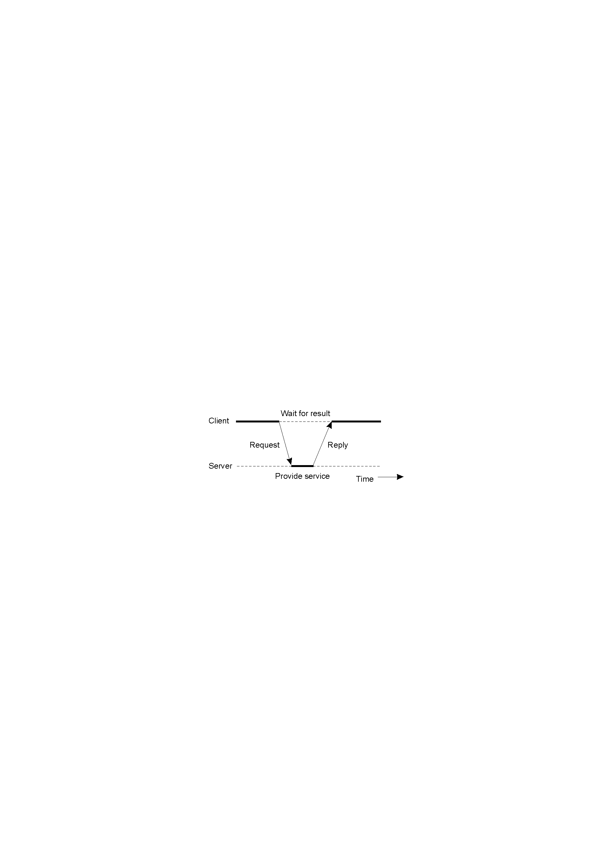
Client-Sever System ctd
Client-Server Application
  Client : Process that request a service
  Server : Process that provides a service
  Client blocks until server responds
  Client is invoked by end users when they require a service
  Server waits for incoming requests
  Server can have many clients making concurrent requests
  Server is a program with special system privileges
DS.

Slide 21
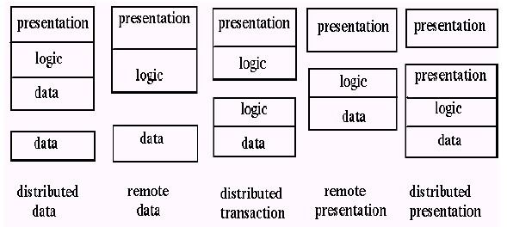
Client-Sever System ctd
Gartner Group’ Configuration(2-tier Architectures)
Applied Examples.
  Distributed data : Distributed databases
  Remote data : Network File systems
  Distributed transaction : World Wide Web(html, java – CGI http server)
  Remote presentation : Telnet
  Distributed presentation : X-Window
Client
system
Server
system
* Gartner Group provides research and analysis of the computer hardware, software, communications, and related information technology industries.

Slide 22
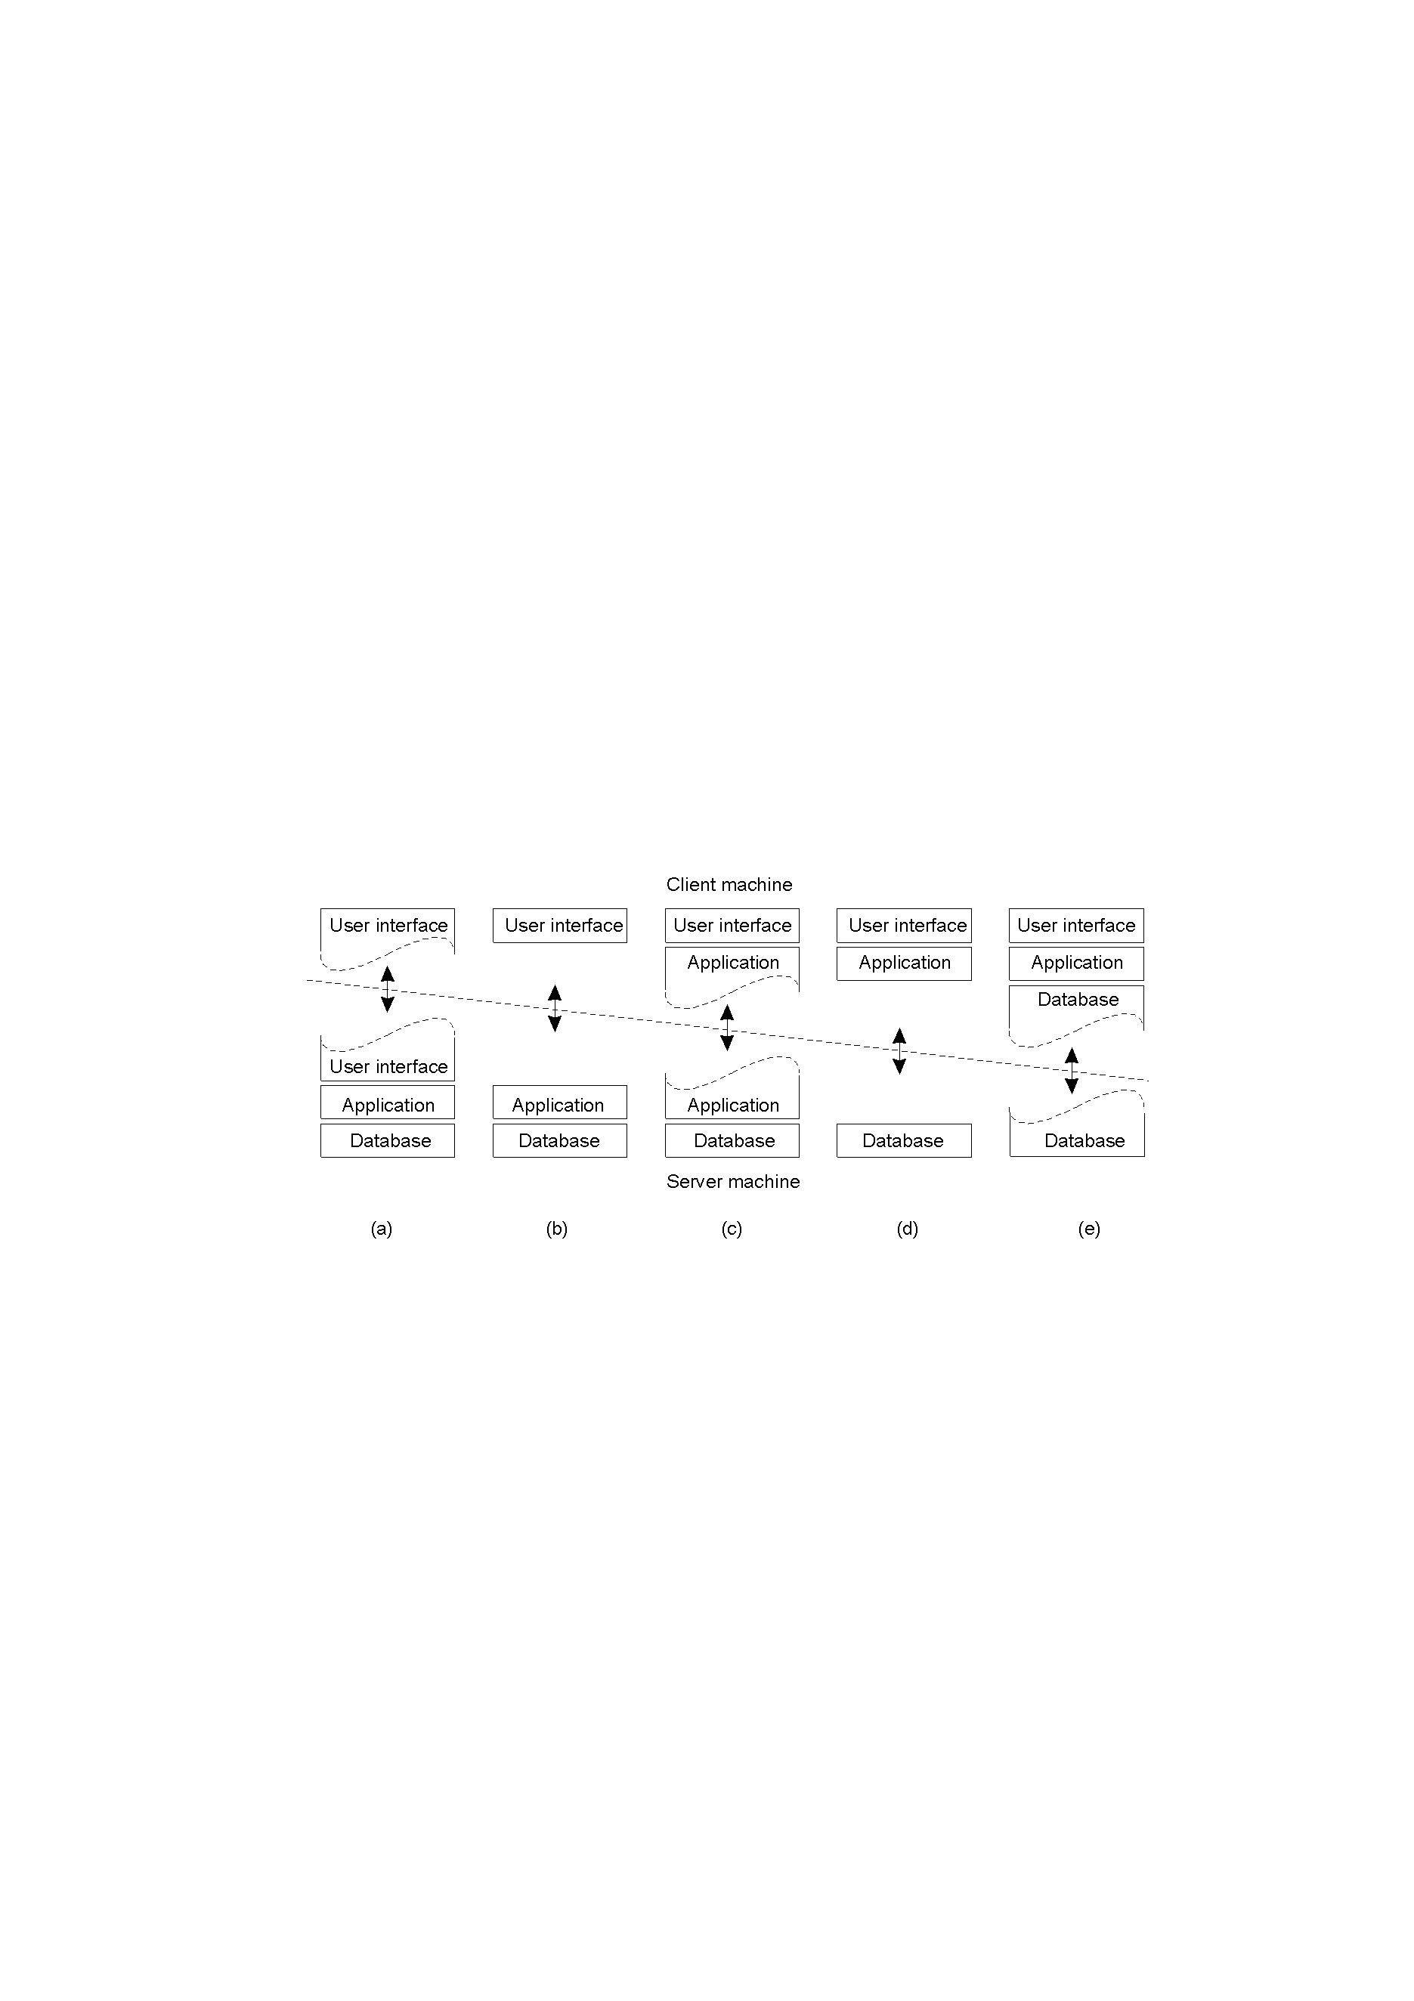
Client-Sever System – Applying Database system ctd
“Gartner Group” - 2-tier Database system’s architecture -
  user interface = presentation, application = logic, database = data
Client
system
Server
system
X-Window
Telnet
World Wide Web(html, java–CGI http server)
  Network File(DB) systems
  Distributed databases

Slide 23
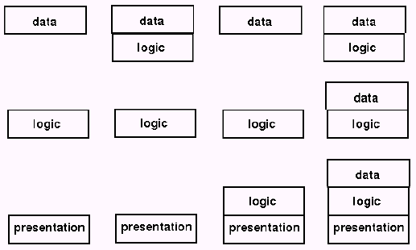
Client-Sever System ctd
Gartner Group’ Configuration(2-tier, 3-tier Architectures)
  Distributed data : Distributed databases
  Remote data : Network File systems
  Distributed transaction : World Wide Web(html, java – CGI http server)
  Remote presentation : Telnet
  Distributed presentation : X-Window
Client
system
Server
system

Slide 24
Software Layers
extended services
available to those of
the distributed system
language and run-time
support for program
Interactions
conventional
and
distributed
applications
applications
Open (distributed) services
Middleware( CORBA, Java RMI, Web service, DCOM, RD-ODP)
responsible for basic local
resource management
(memory allocation/protection,
process creation and
scheduling, local inter-process
communication and peripheral
devices handling)
Operating system
Computer and network (TCP.UDP/IP). hardware
Platform(green part)

Slide 25
Software layers ctd
Service layers
Higher-level access services at lower layers
Services can be located on different computers
Process types:
  server process
  client process
  peer processes(client process + server process)
    Ex. remote conferences

Slide 26
Important layers
Platform
  lowest-level hardware+software( OS + Communication)
  common programming interface
  different implementations of operating system facilities for co-ordination & communication
Middleware
  programming support for distributed computing

Slide 27
Software Concepts
DOS (Distributed Operating Systems)
NOS (Network Operating Systems)
Middleware
System | Description | Main Goal
DOS | Tightly-coupled operating system for multi-processors and homogeneous multicomputers | Hide and manage hardware resources
NOS | Loosely-coupled operating system for heterogeneous multicomputers (LAN and WAN) | Offer local services to remote clients
Middleware | Additional layer atop of NOS implementing general-purpose services | Provide distribution transparency

Slide 28
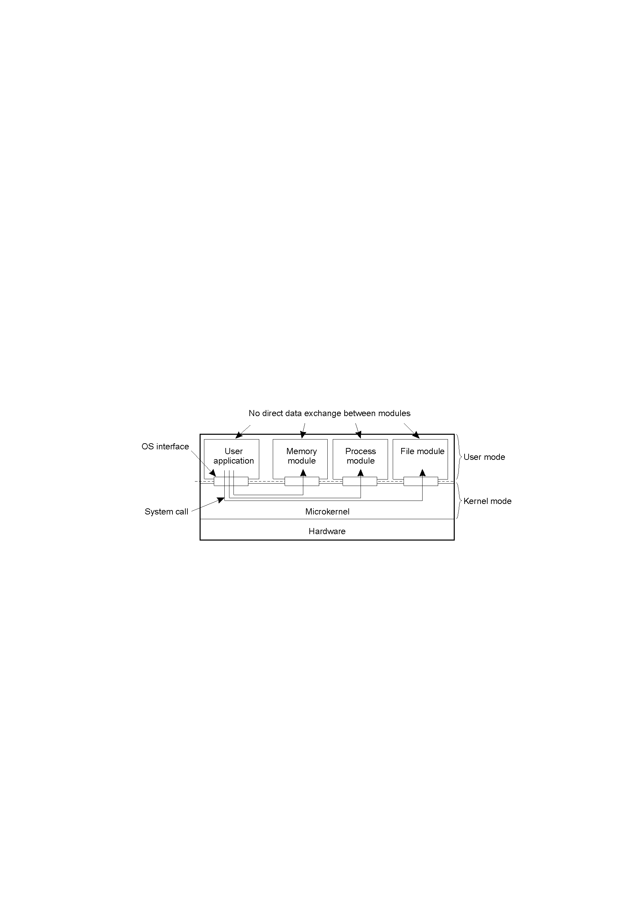
Uniprocessor Operating Systems
Separating applications from operating system code through a microkernel
  Can extend to multiple computers

Slide 29
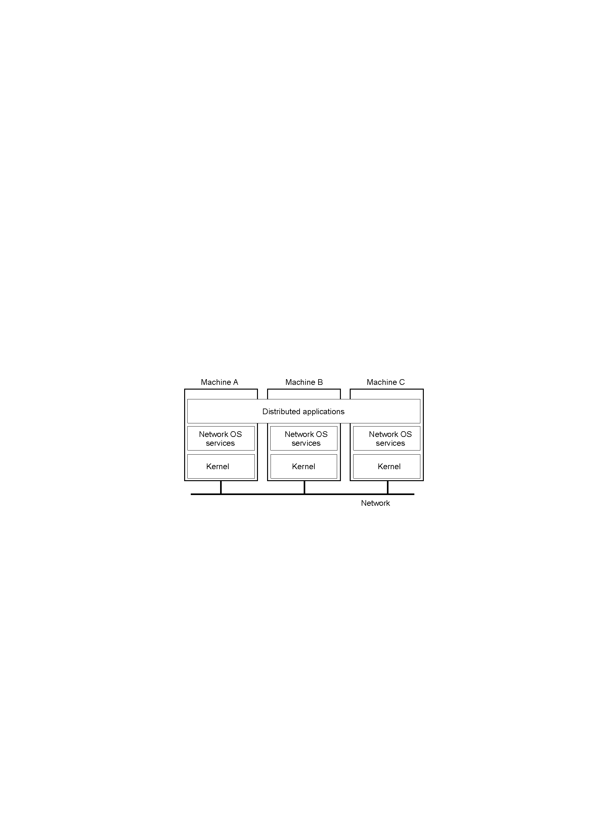
Network Operating System
OSes can be different (Windows or Linux)
Typical services: rlogin, rcp
  Fairly primitive way to share files

Slide 30
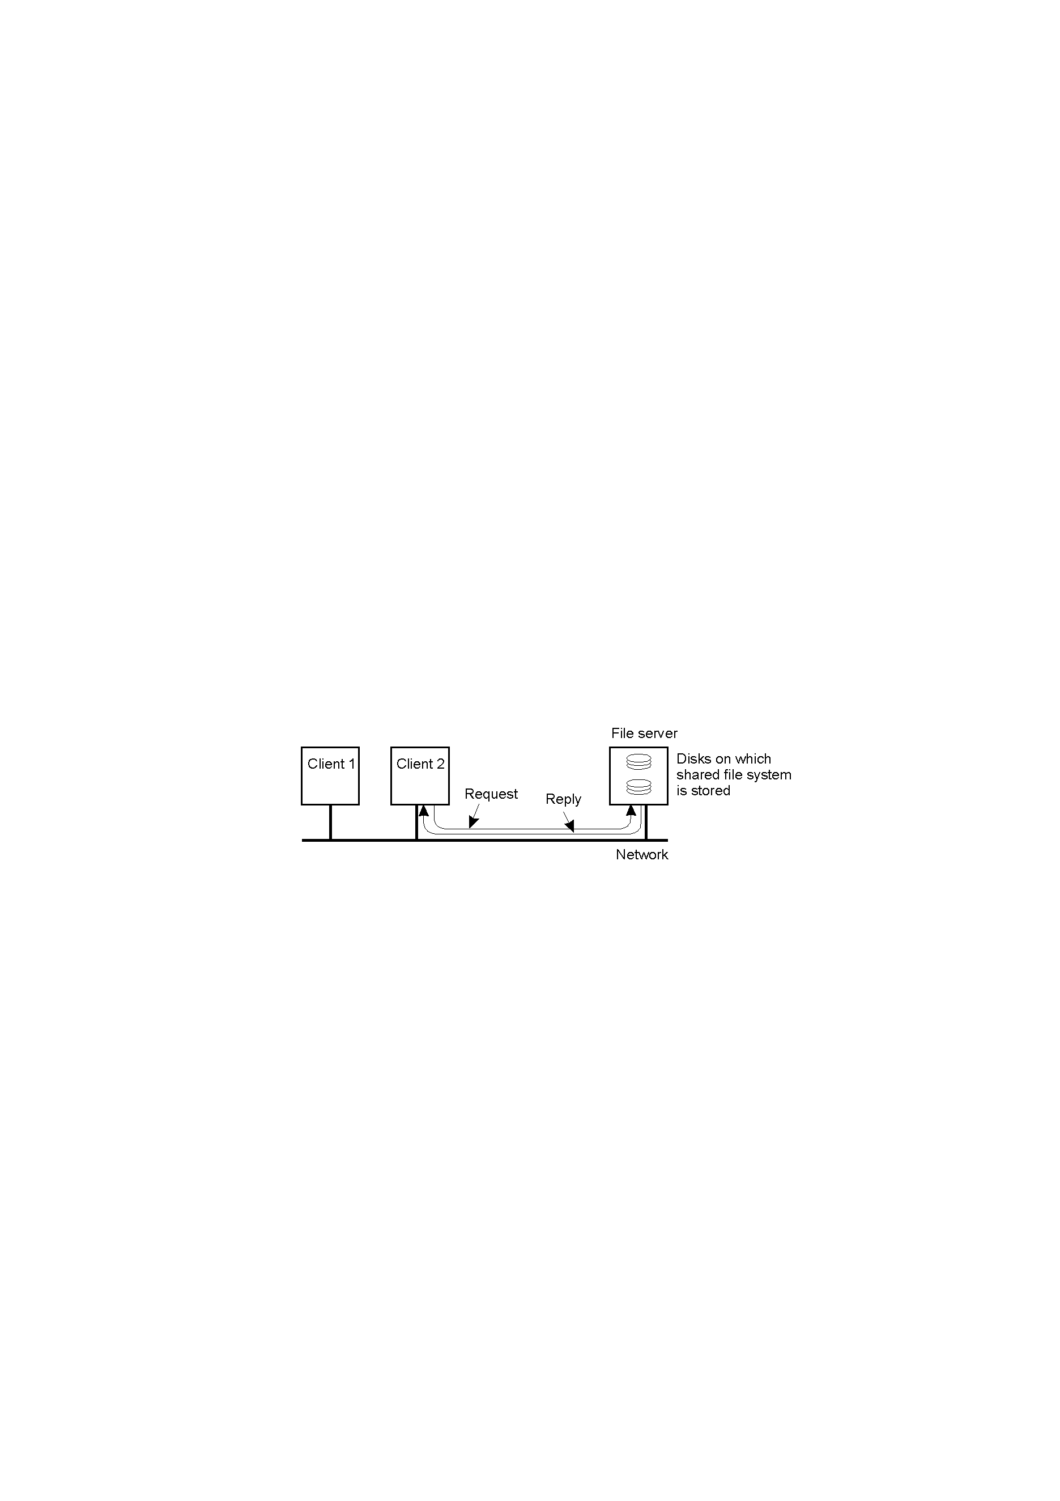
Network Operating System
Can have one computer provide files transparently for others (NFS)

Slide 31
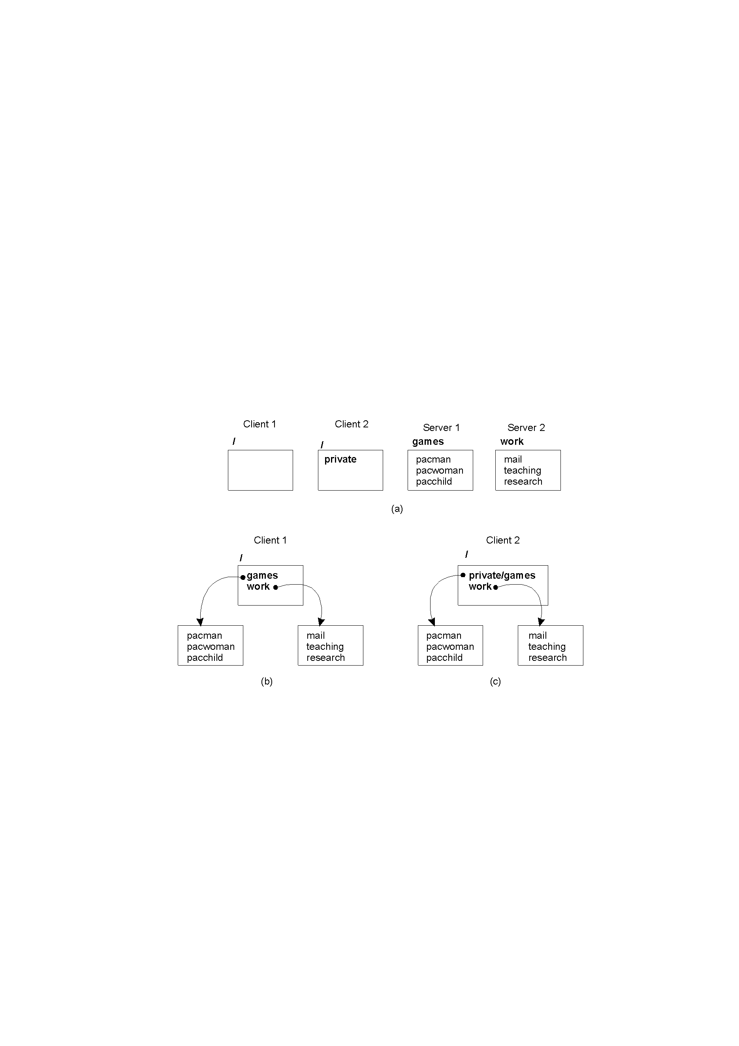
Network Operating System
Different clients may mount the servers in different places
Inconsistencies in view make NOS’s harder, in general for users than DOS’s.
  But easier to scale by adding computers

Slide 32
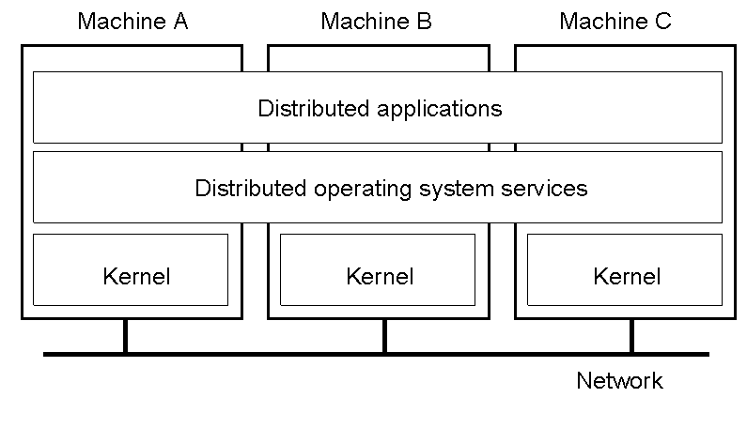
Distributed Operating Systems
But no longer have shared memory
  Provide message passing
  Can try to provide distributed shared memory
    But tough to get acceptable performance

Slide 33

Distributed System as Middleware

Slide 34
Positioning Middleware
Network OS’s are not transparent.
Distributed OS’s are not independent of computers.
Middleware can help.

Slide 35
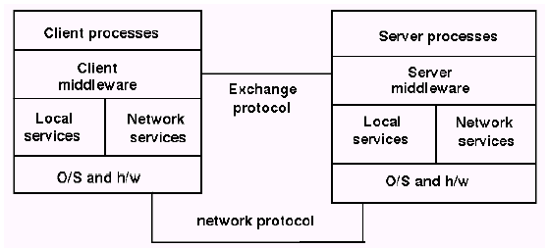
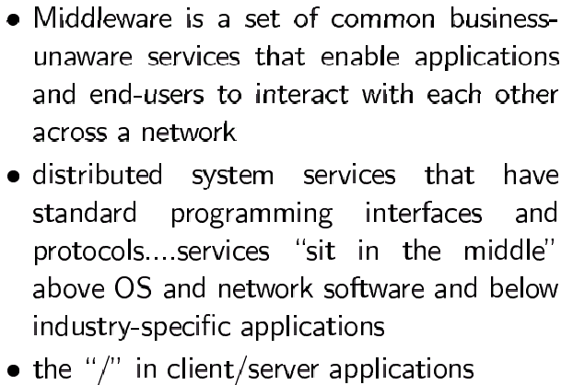
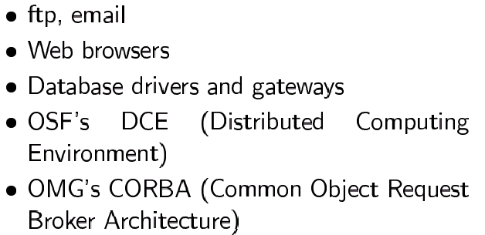
Middleware
Definitions and Examples of Middleware

Slide 36
Middleware provides... ctd
Support for distributed processes/objects:
  suitable for applications programming
  communication via the following mechanisms;
    remote method invocation (Java RMI), or
    remote procedure call (Sun RPC)
Services infrastructure for application programs
  naming, security, transactions, event notification, ...
  Commercial products: CORBA, DCOM,…

Slide 37
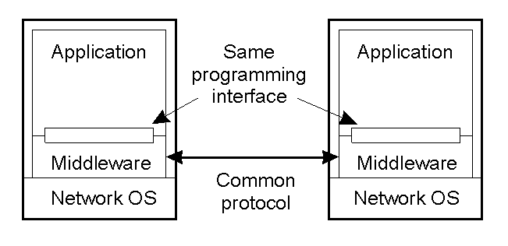
Middleware and Openness
1.23
In an open middleware-based distributed system, the protocols used by each middleware layer should be the same, as well as the interfaces they offer to applications.
  If different, there will be compatibility issues
  If incomplete, then users will build their own or use lower-layer services (frowned upon)

Slide 38
Architectural models
Define
  software components (processes, objects)
  ways in which components interact
  mapping of components onto the underlying network
Why needed?
  to handle varying environments and usages
  to guarantee performance

Slide 39
Main types of Architecture models
* Client-server architecture and Peer-to-peer architecture
Client-server model
  first and most commonly used
Multiple server model
  to improve performance and reliability
  e.g. search engines (more than 1000’s of computers)
Proxy server model
  to reduce load on network,
  to provide access through firewall
Peer process model
  when faster interactive response needed

Slide 40
Client-Server Model
Front server acts as a client for backed servers
Client
invocation
result
Server
Backed server
result
Server
invocation
Front server
Client
Key:
Process:
Computer:

Slide 41
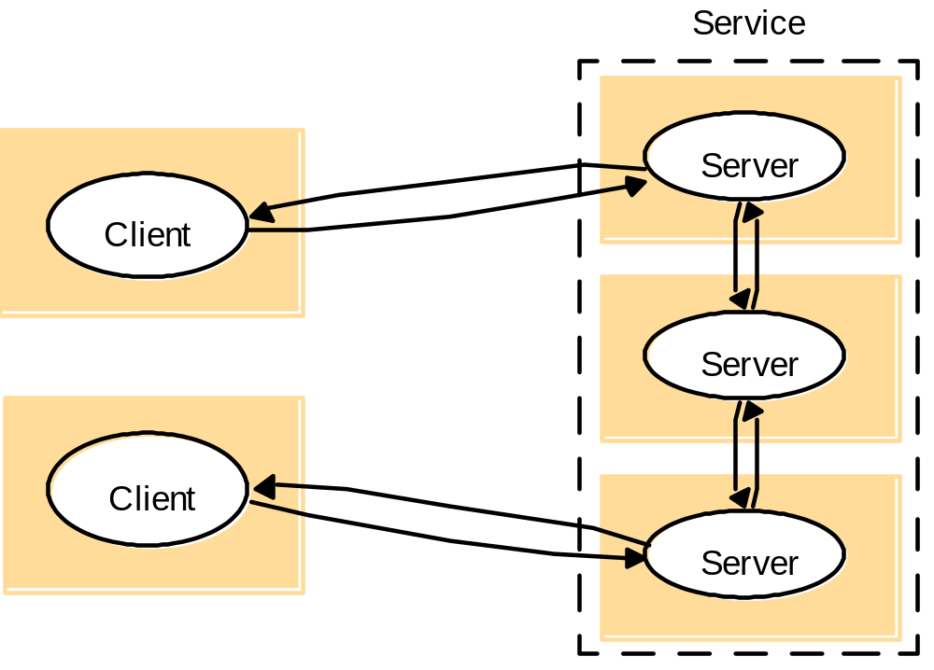
Service Provided by Multiple server Model
Servers may interact
Replicated object, called Replica
- Performance, reliability
- Replicated and distributed database

Slide 42
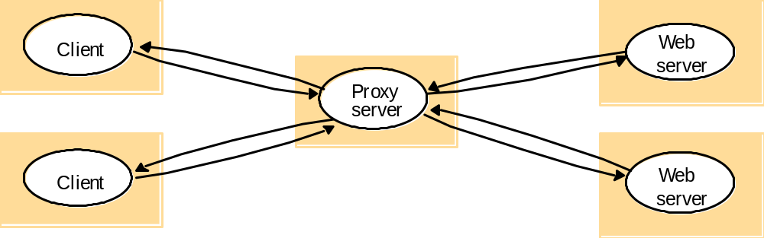
Proxy Server Model and Caching Mechanism
  Caching mechanism

Slide 43
Peer Process Model
Application
Application
Coordination
Coordination
code
code
Application
Coordination
code

Slide 44
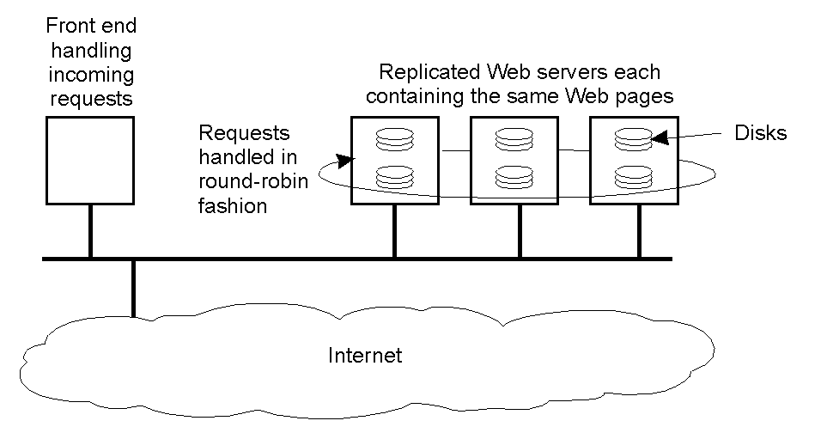
Horizontal Distribution
Distribute servers across nodes
  E.g., Web server for load balancing
Distribute clients in peer-to-peer systems.

Slide 45
Client-server and mobility
Mobile code
  downloaded from server, runs on locally
  e.g. web applets
Mobile agent (code + data)
  travels from computer to another
  collects information, returning to origin
=> Beware! Security risks

Slide 46
Web applets
Client requests results, applet code is downloaded;
Client interacts with applet;
Client
Web
Applet code
server
Web
Client
Applet
server

Slide 47
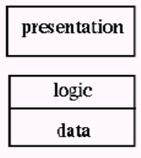
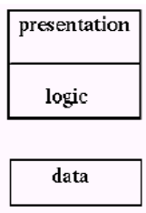
Thin & Fat Clients
Thin client = Network computer
  Typically no local storage
  has only presentation function(= user interface)
Fat Client = Desktop PC, Workstation
  has both presentation function and logic function (=application)
Motivation for Thin Clients
  Hidden costs of System administration and supports
    Networks computers move toward centralized system Admin. , but local processing at client
  Java(mobile code) ← an enabling technology
    E.g. PDA

Slide 48
Design Requirements for Distributed Architectures
Judging how good the architecture is...
1)Performance
  how fast will it respond?
2)Quality of Service(QoS)
  are video frames and sound synchronized?
3)Dependability
  does it work correctly?

Slide 49
1) Performance
Responsiveness
  fast interactive response delayed by remote requests
  use of caching, replication
Throughput
  dependent on speed of server and data transfer
Load balancing
  use of applets, multiple servers

Slide 50
Caching and Replication
Caches and Web Proxy Servers(Proxies)
Cache consistency protocol in Distributed File System
Web-caching protocol in HTTP protocol
  Browsers and proxies can validate a cached response
    If fails, web server returns a fresh response instead of stale response
  Browsers and proxies stores expiry time of cached resource and server time with cached responses
Client
Web
server
Proxy
server
Replicated object
Web
called,
replica
Client
caching
server

Slide 51
2) Quality of Service (QoS)
Non-functional properties experienced by users:
Deadline properties
  hard deadlines (must be met within T time units)
  soft deadlines (`there is a 90% chance that the video frame will be delivered within T time units, ex, 10 units -90%→ 9units)
    multimedia traffic, video/sound synchronization
    depend on availability of sufficient resources
Adaptability
  ability to adapt to changing system configuration

Slide 52
3) Dependability
Correctness
  Ensuring correctness of distributed and concurrent programs
  e.g. use of verification
Fault-tolerance
  ability to tolerate/recover from faults
  e.g. use of redundancy
Security
  ability to withstand malicious attack
  e.g. use of encryption, etc

Slide 53
Fundamental Models for Distributed Systems
Sharing some fundamental properties
  processes that communicate with one another by sending msgs
Essential ingredients of System model
  what are the main entities in the systems ?
  how do they interact ?
  what are characteristics that affect their individual and collective behavior ?
Purpose of system model
  to make explicit relevant assumptions at system modeling
  to generate the concerning possible or impossible assumptions

Slide 54
3 Fundamental Models ctd
Discussions of fundamental models
  Interaction Model
  Failure Model
  Security Model

Slide 55
Interaction Model
Distributed systems
  have many processes, complex interactions among them
    transmission of message between processes(local, remote)
Interacting processing
  communication performance
  impossible to maintain global time( each system has its local time)
Performance of communication channel
  Latency(message, network, system)
  bandwidth
  Jitter

Slide 56
Interaction Model ctd
Computer clocks and timing events
  clock drift rate(Global time needed)
  clock synchronization
Two variants of the interaction model
  Synchronous DS has on;
    process is executing in a known lower/ upper bounded time
    message is received within a known bounded time
    known local clock’s drift rate
  Asynchronous DS has no bounds on;
    process execution speed
    message transmission delay
    clock drift rate

Slide 57
Interaction Model ctd
Event ordering
  X,Y,Z : Meeting Agreements(A)
  Logical ordering
    t1<t2<t3 – physical time
    X sends m1 before Y receives m1; Y sends m2 before X receives m2;
    => considering replies ; Y receives m1 before sending m2.
    must use Logical time[Lamport ’78]
      Using Logical time for Event ordering ( next event No. = current event No + 1)
send
receive
receive
X
1
m
4
6
1
m
send
2
receive
Y
2
3
6
Physical
receive
time
4
2
send
5
Z
receive
receive
m
3
m
1
m
2
A
6
2
4
receive
receive
receive
t
1
t
2
t
3

Slide 58
Failure Model
In DS, processes and channels may failure
  3 failures : Omission, Arbitrary, timing failures
Omission failures
  process omission failures
    Correct, fail-stop, timeouts
  communication failures
    send/receive omission failures
process
p
process
q
send
m
Receive
Communication channel
Outgoing message buffer
Incoming message buffer

Slide 59
Failure Model ctd
  Omission and arbitrary failures
Class of failure
Affects
Description
Fail-stop
Process
Process halts and remains halted. Other processes may
detect this state.
Crash
Process
Process halts and remains halted. Other processes may
not be able to detect this state.
Omission
Channel
A message inserted in an outgoing message buffer never
arrives at the other end’s incoming message buffer.
Send-omission
Process
A process completes as
end,
but the message is not put
in its outgoing message buffer.
Receive-omission
Process
A message is put in a process’s incoming message
buffer, but that process does not receive it.
Arbitrary
Process or
Process/channel exhibits arbitrary behaviour: it may
(Byzantine)
channel
send/transmit arbitrary messages( with wrong values)
at arbitrary times, commit omissions;
a process may stop or take an incorrect step.

Slide 60
Failure Model ctd
Arbitrary failures(=Byzantine failure, Data failure)
  Process/channel exhibits arbitrary behaviour(delivering corrupted, non-existed message )
Timing Failures
The others;
  Masking failures
    Checksum failure
  Failure of reliability of one-to-one communication
    Threats of validity and integrity
Class of Failure
Affects
Description
Clock
Process
Process’s local clock exceeds the bounds on its
rate of drift from real time.
Performance
Process
Process exceeds the bounds on the interval
between two steps.
Performance
Channel
A message’s transmission takes longer than the
stated bound.

Slide 61
Security Model
Protecting objects
Securing processes and their interactions
  introducing a model for analysis of security threats
  the enemy
    threats to process and channel
Access rights
Object
invocation
Client
result
Server
Principal (user)
Network
Principal (server)

Slide 62
Security Model ctd
    Defecting security threats ➔ Threat model
      cryptography and shared secrets
      authentication(sender id)
      secure channels
      denial of service, mobile code ?
Copy of
m
The enemy
m’
Process
p
m
Secure channel
Process
q
Communication channel

Slide 63
Summary
Choose between one tier, two tier, …
  simple versus complex transaction processing
Client-server architecture model : most common
  2-tier and 3-tier Client-Server Architecture
  used for WWW, email, ftp, Internet services, etc
Architecture Models
  Client-server model
  Multiple server model
  Proxy server model
  Peer process model
Distributed architecture using above models
  Expect to meet requirements of Performance, QoS and Dependability

Slide 64
Summary ctd
Fundamental models for distributed systems
  Interaction model
  Failure model
  Security model

Slide 65
2,3-tier Client-Server system – using JDBC 3-tier and CORBA in DS
Java Applet or
Application
Client Machine
Java Applet or
Application
Client Machine
Client Machine
Client Machine
Java Applet or
HTML Browser
Java Applet or
HTML Browser
JDBC API
Java
Application
JDBC API
Java
Application
IDL Stub
HTTP, RMI or
CORBA calls
IDL Stub
HTTP, RMI or
CORBA calls
JDBC
JDBC
OutputStream
OutputStream
Server Machine
(Business Logic)
Server Machine
(Business Logic)
Object Request Broker
Object Request Broker
Java
Application
Java
Application
InputStream
DBMS Proprietary
Protocol
InputStream
DBMS Proprietary
Protocol
JDBC
JDBC
IDL Skeleton
IDL Skeleton
Middleware
Middleware
DBMS Proprietary
Protocol
DBMS Proprietary
Protocol
Other general JDBC Driver
Database Server
Other general JDBC Driver
Database Server
DBMS
DBMS
Database Server
Database Server
DBMS
DBMS
DBMS
DBMS
2 Tier Model
2 Tier Model
3 Tier Model
3 Tier Model
ORB-JDBC Model
ORB-JDBC Model

Slide 66
Client-Server system
Visual
Client
Web Server
Call
Method
Server API
Application
Application
DB Interface
DB-Con
Database
Visual
Client
Oracle Web Server
Visual
Client
Microsoft Visual Studio(FrontPage, ASP, IIS, OLE DB, ADO)
ODBC
Database
Visual
Client
Web Server
CGI
Execution binary or Scripts (PERL)
Database
Visual
Client
Web Server
ISAPI
NSAPI
DLL
Database
Visual
Client
Web Server
CGI
WinCGI
PB / VB / 4GL
Database
Visual
Client
Web Server
CGI
NSAPI
CGI relay
NS, IS DLL
RPC
Application
Database
PlugIn
Client
Web Server
Java, PowerBuilder, PowerObject
JDBC, ODBC
Database
Visual
Client
Web Server
CGI
NSAPI
Illustra WebDriver
Webdaemon
Socket
Database
Visual
Client
Web Server
CGI
NeXT WebObjects
ODBC
Database

Slide 67
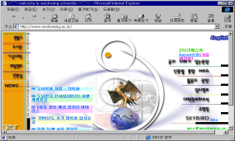
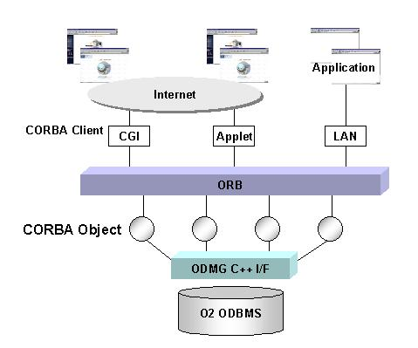
CGI Web Applications
WWW browser
URL, Req.
Web Server
Ext. Pro.
HTTPD
HTML (Res.)
CGI
Ext. Pro.
Java/Client Web Application
Java installed browser
URL, Req.
Web Server
Java prog.
HTTPD
Java code
Java prog.
Direct handling
CORBA-Java Web Application
Java installed browser
C
O
R
B
A
URL, Req.
Web Server
DataBase
HTTPD
Java code
File System
Direct handling

